Slide 1

Creating an alternative
news source

Slide 2
The Problem
News articles are always biased

Slide 3
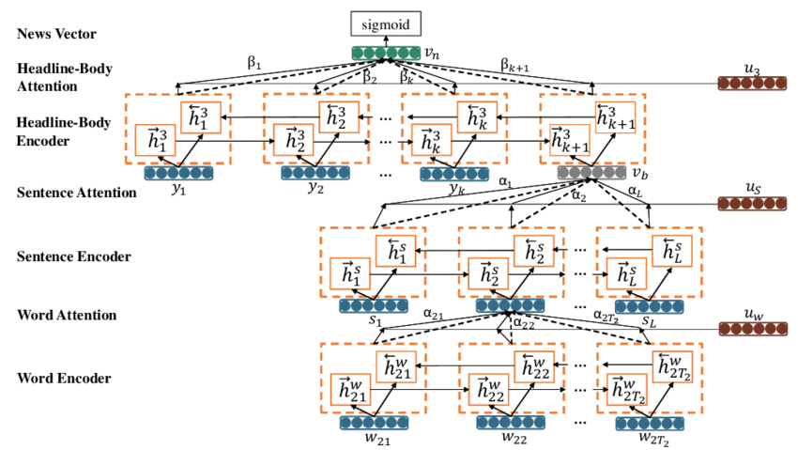
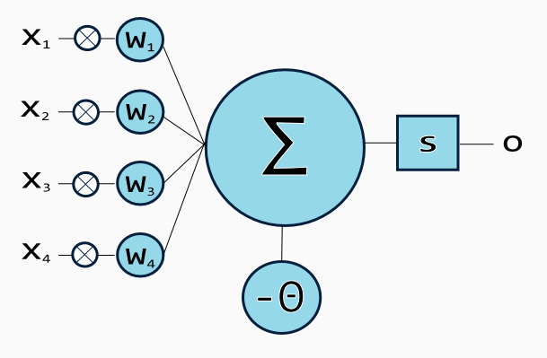
The Solution
Neural Networks
Natural Language Processors
Universal Data Collection
Transparencies

Slide 4
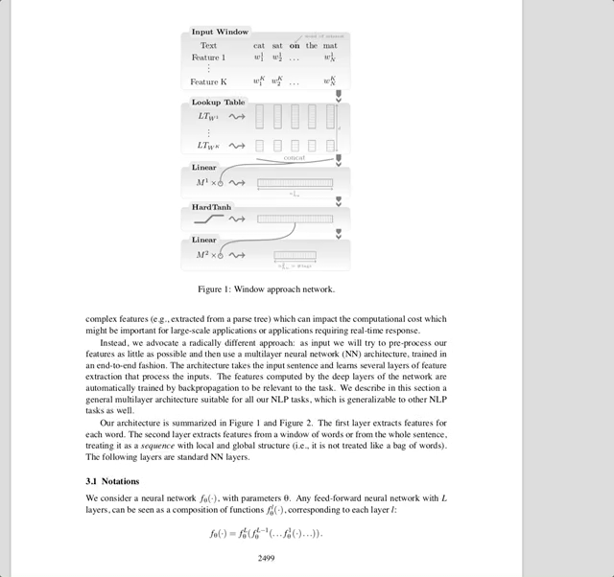
Research

Slide 5
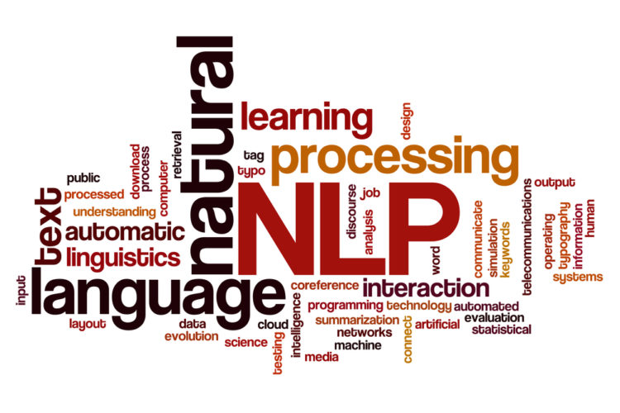
What We Did
Implementation of NLP
Creation of a news website
ooper.space/news/public

Slide 6
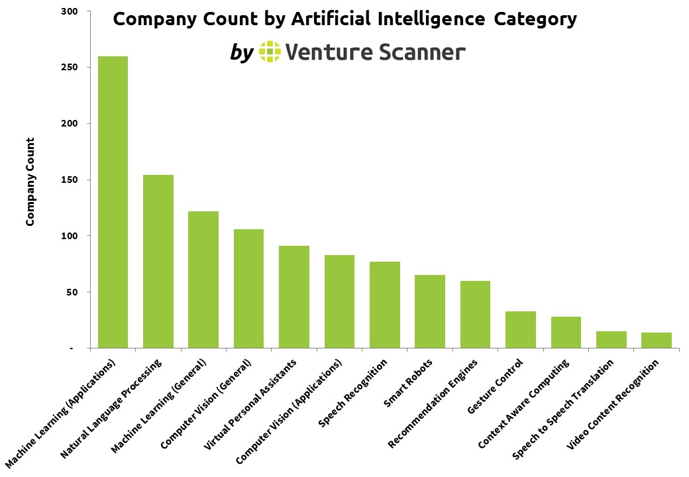
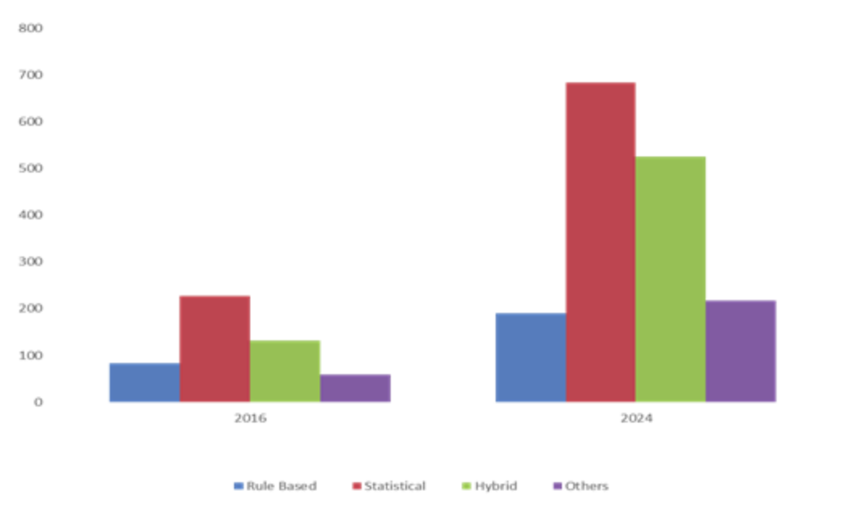
The Rewards
SIX BILLION DOLLAR INDUSTRY

Slide 7
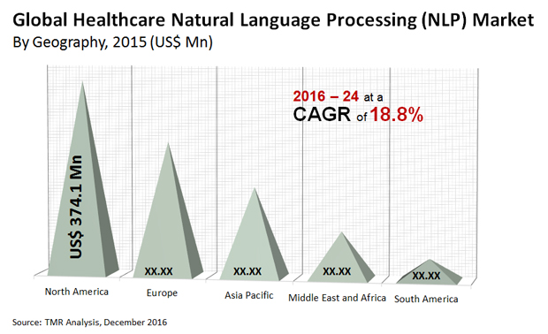
Whats next?
Properly train our summarization system
Refine our user interface
Develop further innovations

